Slide 1
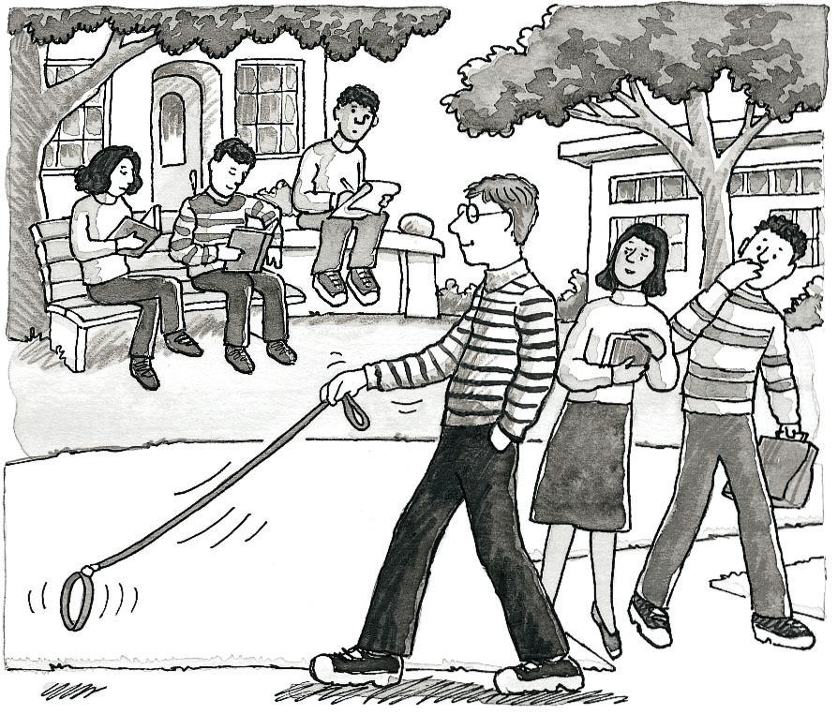
Observational Research
Non-experimental methods that involve observing and systematically record the behavior of individuals
Notes:
Naturalistic research: designed to described and measure the behavior of people or animals as it occurs in their every day lives. This is what we are describing when we use the descriptive research strategy by organizing the observed data into meaningful measured variables that can be analyzed.
Observational- making observations of behavior and recording observations in an objective manner
Purpose:
To gather data on which further studies can be based
To provide evidence for or against theories

Slide 2

Descriptive Research Strategy
Measuring variables as they exist naturally
Not examining a relationship
Useful for preliminary research
Purely… well, “descriptive”
Notes:
Naturalistic research: designed to described and measure the behavior of people or animals as it occurs in their every day lives. This is what we are describing when we use the descriptive research strategy by organizing the observed data into meaningful measured variables that can be analyzed.

Slide 3
Two Main Approaches to Observation
QUANTITATIVE
QUALITATIVE
Assigns numerical values to responses and measures
Focuses on specific behaviors that can be easily quantified
Uses large samples (ideally)
Is subject to statistical analyses like any other variables
Data are non-numerical and expressed in language and/or images
Focuses on behavior in natural settings
Small groups and limited settings
Describe or capture themes that emerge from the data

Slide 4
Observational Research Design
The researcher observes and systematically records the behavior of individuals in order to describe the behavior
Purpose:
To gather data on which further studies can be based
To disprove theories
Notes:
Observational- making observations of behavior and recording observations in an objective manner
We tend not to use naturalistic observation
Thoughts cannot be observed

Slide 5
Observational Design
Designed primarily to be descriptive
No attempt to manipulate the environment
Systematic recording of naturally occurring events/behaviors
Descriptive research cannot predict an event
Notes:
Observational- making observations of behavior and recording observations in an objective manner
We tend not to use naturalistic observation
Thoughts cannot be observed

Slide 6

Types of Observational Research
Naturalistic (field) observation
Participant observation
Structured observation
Case study
Archival Research
Survey research

Slide 7
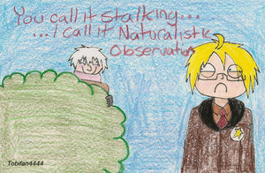
Naturalistic (Field) Observation
The observation of behavior in a natural setting as unobtrusively as possible
Example: Researchers noticed how people rarely bumped into each other in a crowd, so they set up a bird’s-eye-view video to observe a busy cross-section and noted frequency of accidents, awkward moments, and other social interactions.
Strengths | Weaknesses
Behavior observed in the real world Useful for non-manipulated behaviors Actual behaviors observed and recorded | Time consuming Potential for observer influence Potential for subjective interpretation

Slide 8
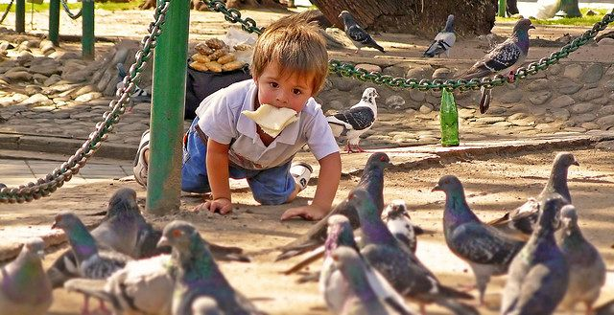
Participant Observation
Researcher engages in same activities as the people being observed in order to observe and record behavior
Example: David Rosenhan (1973) and his colleagues checked themselves into different psychiatric institutions pretending to have hallucinations in order to examine how patients were treated when they actually did not present with any real symptoms.
Strengths | Weaknesses
When natural observation is impossible Get information no accessible otherwise Participation gives unique perspective | Time consuming Potential loss of objectivity Increased chance for observer influence
Notes:
Rosenhan (1973) “on being sane in insane places”
12 adults went to different psychiatric hospitals and gave the same story (hearing voices, DSM classified as “Existential Symptoms”) changing only their names and residences. All were admitted and diagnosed and kept for 52 days. Once admitted, they behaved normally, pretending to take any prescribed meds. When discharged, were said to be “schizophrenic in remission”. Study showed that once these people were labeled as patients, they were no longer treated normally.

Slide 9
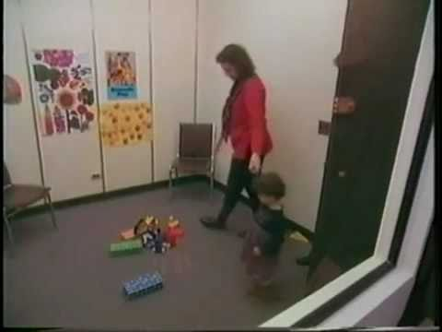
Structured (Contrived) Observation
Settings arranged specifically to facilitate the occurrence of specific behaviors
Example: Mary Ainsworth (1969) designed the “Strange Situation” paradigm to observe attachment behaviors in babies and young children. Parents bring the child into the lab to play, parent leaves, stranger enters, stranger leaves…
Strengths | Weaknesses
Do not have to wait for behaviors to occur Researcher has more control | Less naturalistic
Notes:
In this procedure of the strange situation the child is observed playing for 20 minutes while caregivers and strangers enter and leave the room, recreating the flow of the familiar and unfamiliar presence in most children's lives. The situation varies in stressfulness and the child's responses are observed. The child experiences the following situations:
Parent and infant are introduced to the experimental room.
Parent and infant are alone. Parent does not participate while infant explores.
Stranger enters, converses with parent, then approaches infant. Parent leaves conspicuously.
First separation episode: Stranger's behavior is geared to that of infant.
First reunion episode: Parent greets and comforts infant, then leaves again.
Second separation episode: Infant is alone.
Continuation of second separation episode: Stranger enters and gears behavior to that of infant.
Second reunion episode: Parent enters, greets infant, and picks up infant; stranger leaves conspicuously.
Four aspects of the child's behavior are observed:
The amount of exploration (e.g. playing with new toys) the child engages in throughout.
The child's reactions to the departure of its caregiver.
The stranger anxiety (when the baby is alone with the stranger).
The child's reunion behavior with its caregiver.
On the basis of their behaviors, the children were categorized into three groups, with a fourth added later. Each of these groups reflects a different kind of attachment relationship with the caregiver.

Slide 10
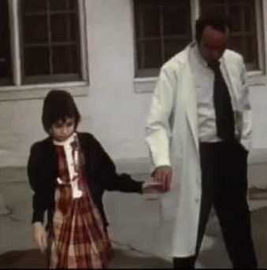
Case Study Design
In-depth study and detailed description of a single individual (or very small group)
Examples: Freud’s discussion of specific patients; Patients with rare patterns of neurological damage (e.g. HM, Phinease Gage, etc.); Individuals with unusual backgrounds (e.g. Genie).
Strengths | Weaknesses
Detailed description Vivid, powerful, convincing Compatible with clinical work Can study rare and unusual events Can identify exceptions to the rule | Limited generalization Potential for selective bias Potential for subjective interpretation
Notes:
Case studies- qualitative research design that uses descriptive records of one or more individual experiences or behavior.
The assumption here is that by carefully studying individuals who are socially marginal or who are experiencing a difficulty time, we can learn something about human nature in general.
Usually used for clinical cases
Freud was a master of the case study—he did case studies of some of his most interesting patients and used these to develop his important theories of personality.
The Case History – when no treatment or intervention is involved
Psychobiography = applies psychological theory to explain the life of an individual
Sometimes case studies involve normal individuals (Piaget’s study of his own children’s cognitive development), but more frequently, case studies are conducted on individuals who have unusual or abnormal experiences or characteristics or who are going through stressful situations.
STRENGTHS AND WEAKNESSES
One problem with case studies is that they are based on the experiences of only a very limited number of normally quite unusual individuals. Although these may be extremely interesting, they cannot usually tell us much about whether the same things would happen to other individuals in similar situations or exactly why these specific reactions to these events occurred.
Also, because there is no comparison group that DIDN’T experience the stressful situation, we cannot know what these inidividuals would be like if they hadn’t had the experience. As a result, case studies provide only weak support for the drawing of scientific conclusions.

Slide 11
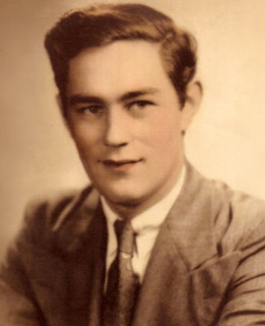
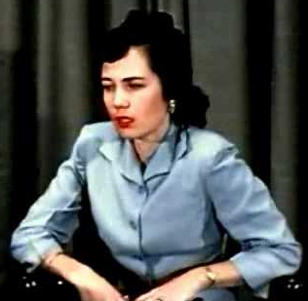
Applications of the Case Study
Rare phenomena and unusual clinical cases
H.M.
Eve White/Eve Black & Jane
Genie
As counterexamples
Uses the case of single individual to illustrate exception to the rule of established research

Slide 12
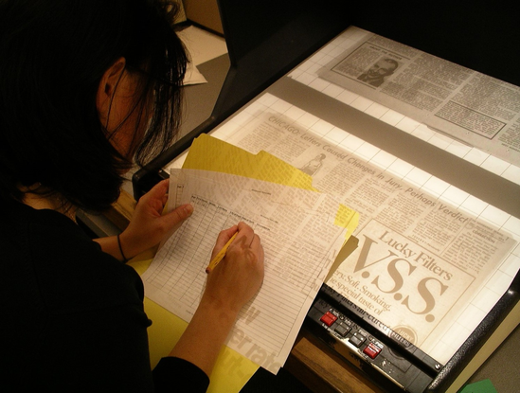
Archival Research
Indirect observations of behavior
Using previously compiled information to answer research questions
Examples: Using statistical records collected in the past; Survey archives; Public survey research like the General Social Survey or census data; Written communication records; Can include content analysis of archived documents
Strengths | Weaknesses
Can address questions that can be addressed in no other ways | May be difficult to obtain Cannot be sure of accuracy of records
Notes:
A lot of research focuses on studying behaviors that already occurred (and have been written about), or that occur in movies or books. In these cases, the measurement process is called content analysis.
Historical longevity studies utilize public birth/death records

Slide 13

Running an observational study
Decide on what exactly you are going to observe
Be specific! Operational definitions are key
Decide on a strategy or method to collect information
Establish ways of measuring reliability of observations
Notes:
Decide how specific you want the information to be
Molecular (microanalytic techniques)
Molar (macroanalytic techniques)

Slide 14
Methods used to get information
Running an observational study

Slide 15
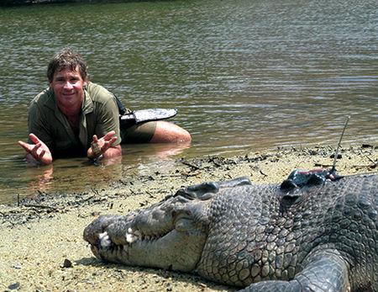
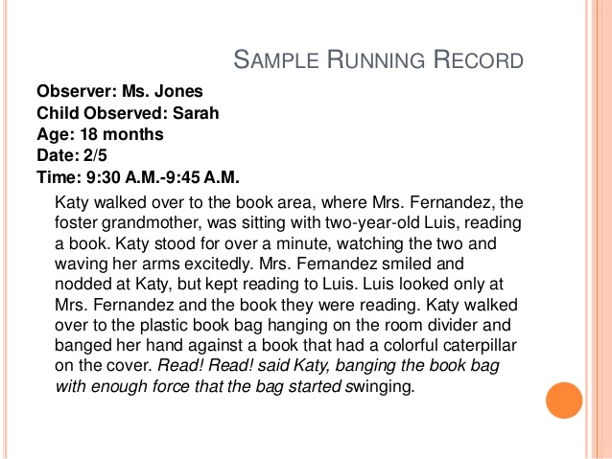
Running Narrative
A continuous description of what the observer sees during the course of events
Results in a huge amount of data
Costly and time consuming
Difficult to control for observer bias

Slide 16
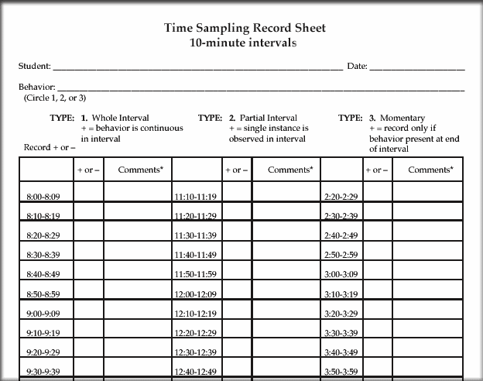
Time Sampling (Interval Method)
The entire observation period gets broken down into intervals of time and the observer records whether the behavior of interest occurs or not during each interval
Used when you know a behavior will occur repeatedly
Recording is usually categorical, thus very simple
Minimizes errors due to forgetting or fatigue
Notes:
During how many intervals of time in a fixed time period did your participant engage in a specific behavior or interest?

Slide 17
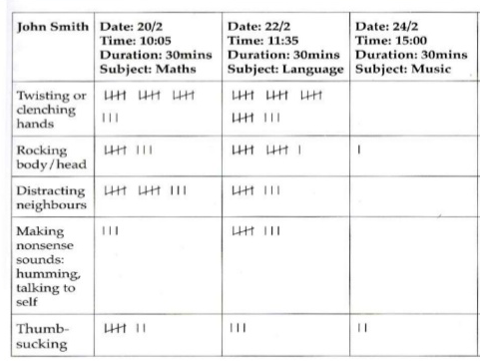
Event Sampling (Frequency Method)
The frequency (number of times) the behavior of interest occurs during a period of observation is recorded
A more fine grained record of behavior is obtained than in time sampling
Can also record duration or intensity of behaviors
Often used when behavior is relatively infrequent
Notes:
How many times in a fixed time period did your participant exhibit the specific behavior of interest?

Slide 18
Things to keep in mind…

Slide 19
When using observational methods…
Behaviors must not be influenced/disturbed
Concealment of observer
Habituate participants to observer’s presence
Some degree of subjective interpretation
Have very specific and well-defined categories of observations
Use well-trained observers
Measure reliability
Keep a film record that can be reviewed later by another observer
Assess Inter-rater reliability across multiple observers
Notes:
Observer Bias = every observer is going to have a set of beliefs and expectations that will cloud their view of the observation
Confirmation bias = looking for behaviors to confirm beliefs
Causal bias = perception of non-meaningful behaviors as meaningful
Observer Drift = the observer’s way of observing may shift over the course of the investigation
Sampling = because we cannot observe everything we may miss examples of important behaviors
Inter-rater reliability is a measure of observational quality

Slide 20
Observational Methods Overall
Strengths
Weaknesses
Terrific source of hypotheses for experiments
Naturalistic - recording actual behavior
High external validity
Flexible
We can use observational methods in conducting experiments
Ethical concerns
Reactivity = people know they are being watched and may change their behaviors
Humans are fallible observers; we miss a lot
Delimiting = breaking up behavior into pieces
Good Operational definitions are difficult sometimes
Description is open to bias

Slide 21
Possible Issues in Observation
Observer Bias = every observer is going to have a set of beliefs and expectations that will cloud their view of the observation
Confirmation bias = looking for behaviors to confirm beliefs
Causal bias = perception of non-meaningful behaviors as meaningful
Observer Drift = the observer’s way of observing may shift over the course of the investigation
Sampling = because we cannot observe everything we may miss examples of important behaviors

Slide 22
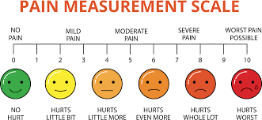
Survey Design
According to the Pain Scale, how do you feel today?
Notes:
ASK: what is survey research?
Employs questionnaires and interviews to ask people to provide information about themselves
Attitudes and beliefs
Demographics (age, gender, income, marital status, etc.) and other facts about themselves
Past or intended future behaviors
Rests on an assumption that people are willing and able to provide truthful and accurate answers
Provides methodology for asking people to tell about themselves
To study relationships between/among variables
To study how attitudes and behaviors change over time
Provides useful information for making public policy decisions
Important complement to experimental research findings
Personal administration to groups or individuals
Questions are presented in written format and respondents write their answers
“Paper-and-Pencil Questionnaire”
Inexpensive and anonymous
Mail surveys
Can be mailed; relatively inexpensive to administer
Internet surveys
Easy to design and administer
Other technologies
Computerized experience-sampling via Palm Pilots first, now iPhones
What are some issues with these methods?
Face-to-face interviews
Require a meeting for the interview
Time, facilities, transportation costs
Telephone interviews
Data collected relatively quickly and at less cost
Focus group interviews
Expensive, but yields good information
What is a problem with these methods?
Interviewer bias
The survey questions must be tied to the research questions that are being addressed
Attitudes and beliefs
Questions focus on the ways that people evaluate and think about issues
Facts and demographics
Factual questions ask people to indicate things they know about themselves and their situation
Behaviors
Questions can focus on past behaviors or intended future behaviors

Slide 23
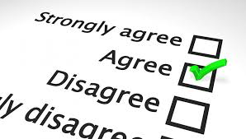
Survey Research
Invite participants to complete surveys/questionnaires that measure various attitudes, psychological traits, etc. Can be descriptive or correlational.
Examples: Polling in political campaigns to find out which type of people support which type of candidate; personality assessments.
Strengths | Weaknesses
Relatively easy (and cheap) to get lots of data Can find relationships between variables of interest that drives future research | Cannot infer causal relationships between variables Reliability and validity of measures is more difficult to determine than most realize

Slide 24
Closed- vs. Open-ended Questions
What is your ethnicity? _______________
vs.
What is your ethnicity (check one):
__White __Black __Latino __Asian __Other
Pros and cons for each?
Notes:
Number of response alternatives
With closed-ended questions, there are a fixed number of response alternatives:
___Yes ___No 1 = totally disagree, 5 = totally agree

Slide 25
Closed-Ended Questions
Multiple choice
Rating Scales
Likert-type
Semantic Differential

Slide 26
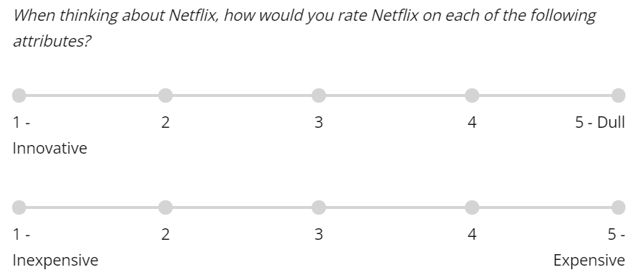
Semantic Differential Scales
Participants indicate feelings between two polarized options

Slide 27
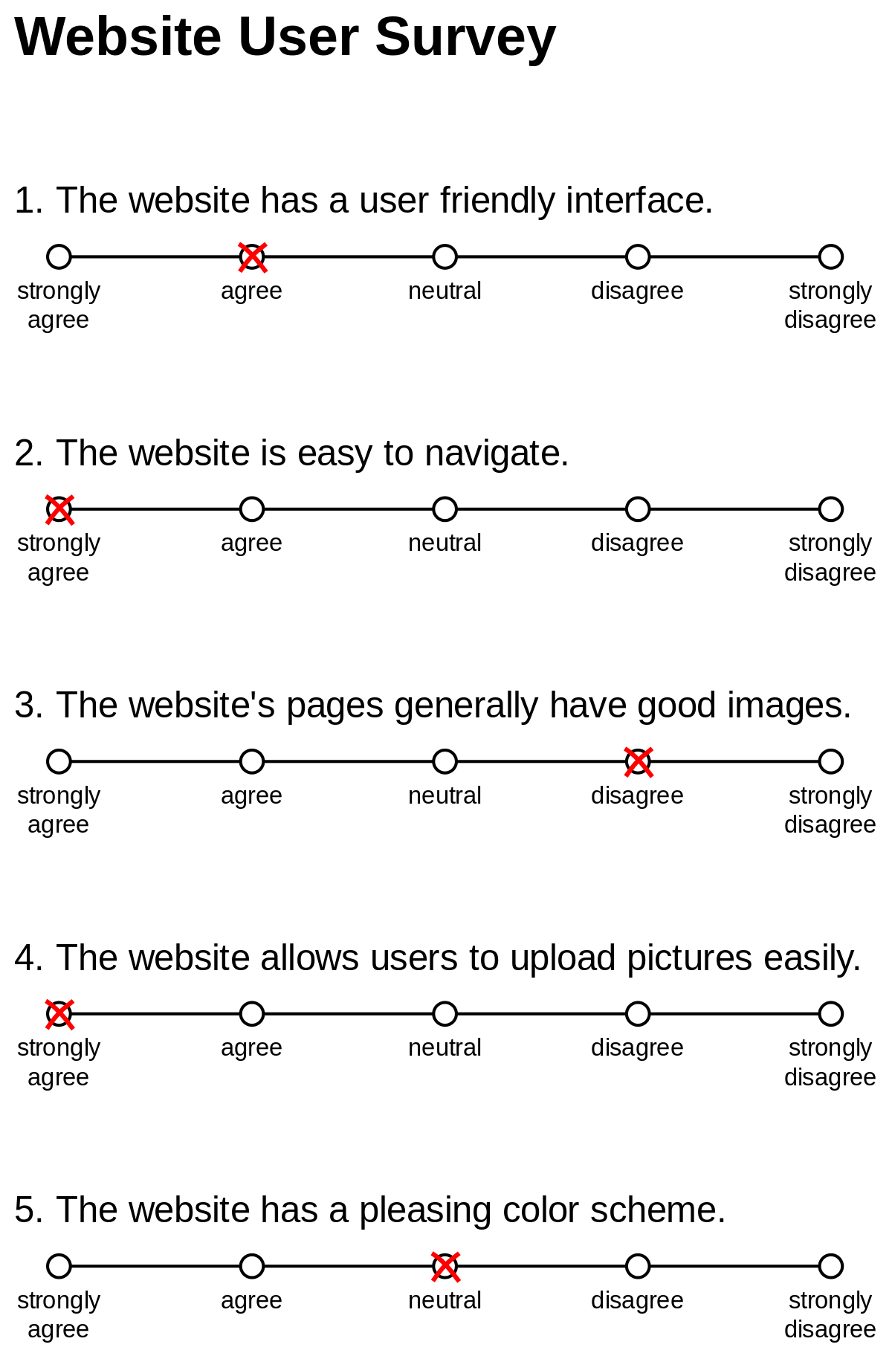
Rating (Likert) Scales
Participants indicate level of agreement with statements
Notes:
Rating scales / Likert Scale
I am satisfied with my semester thus far
strongly disagree
somewhat disagree
neither agree nor disagree
somewhat agree
strongly agree

Slide 28
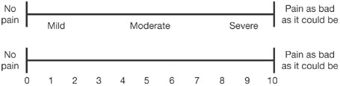
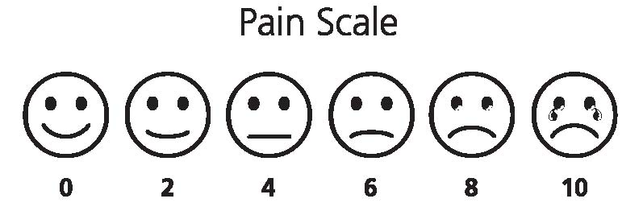
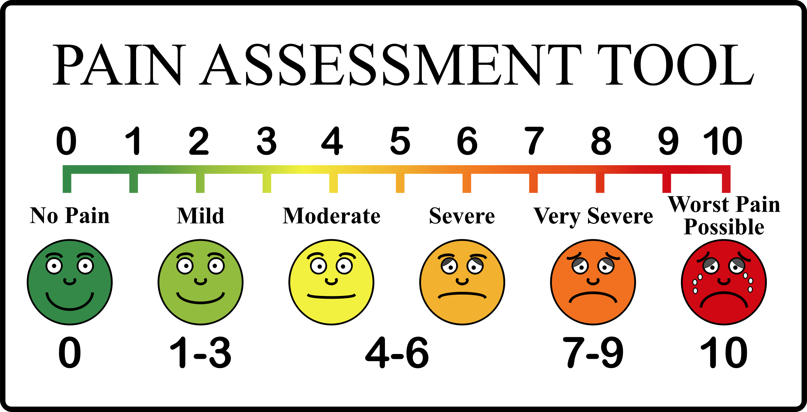
Visual rating scales
Notes:
Rating scales / Likert Scale
I am satisfied with my semester thus far
strongly disagree
somewhat disagree
neither agree nor disagree
somewhat agree
strongly agree

Slide 29
Anchors Matter
Your choice of anchor changes the meaning of a question:
How satisfied are you with your semester thus far?
(Not at all)
(Extremely)
(Not very much)
(Completely)
(Not at all)
(Slightly)
(Quite)
(Mostly)
(Very)
(A great deal)
(Extremely)

Slide 30
Anchors Matter
2. The spacing of your intervals must be equal!
How satisfied are you with your semester thus far?
(Not at all)
(A little)
…
…
…
…
(Infinitely)
(Extremely unsatisfied)
(Neither satisfied nor unsatisfied)
(Extremely satisfied)

Slide 31
Anchors Matter
3. Bipolar scales can be useful
How satisfied are you with your semester thus far?
(Extremely unsatisfied)
(Neither satisfied nor unsatisfied)
(Extremely satisfied)
-3. (Extremely unsatisfied)
-2.
-1.
0. (Neither satisfied nor unsatisfied)
1.
2.
3. (Extremely satisfied)
Unipolar scale
Bipolar scale

Slide 32
Anchors Matter
4. It’s sometimes useful to include a neutral midpoint
How satisfied are you with your semester thus far?
-2. (very dissatisfied)
-1. (dissatisfied)
0. (neutral)
1. (satisfied)
2. (very satisfied)
-2. (very dissatisfied)
-1. (dissatisfied)
1. (satisfied)
2. (very satisfied)
No neutral point
Neutral point

Slide 33
Let’s try it…
Draft some survey questions to assess:
People’s attitudes towards food available on campus (and what factors might influence these attitudes)
How much students like being at SUNY Purchase

Slide 34
Ten Rules of survey construction

Slide 35

Thou shalt not…
Use double-barreled questions
How much do you agree that introducing a public health insurance option would reduce costs and insure more Americans?

Slide 36

Thou shalt not…
Use negation (unless absolutely necessary)
How much do you disagree with Prof Hess that designing research is fun?
Especially true for double negation!
How much do you disagree with Prof Hess that candy corn is the worst candy ever?

Slide 37
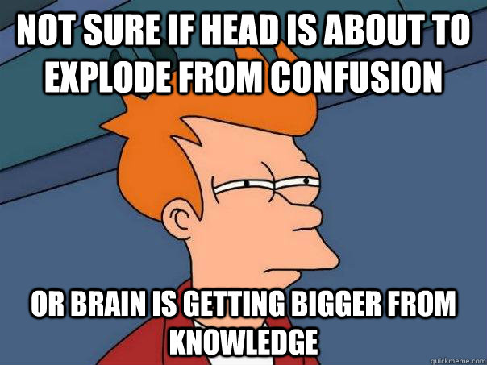
Thou shalt not…
Use technical jargon and complex language
To what extent do you agree with the anarcho-capitalist critique of neo-Marxist eschatology?

Slide 38

Thou shalt not…
Use questions that do not yield variance
Do you think my kids are cute?
Notes:
An unwanted restriction of the range
Leads to “floor” and “ceiling” effects

Slide 39
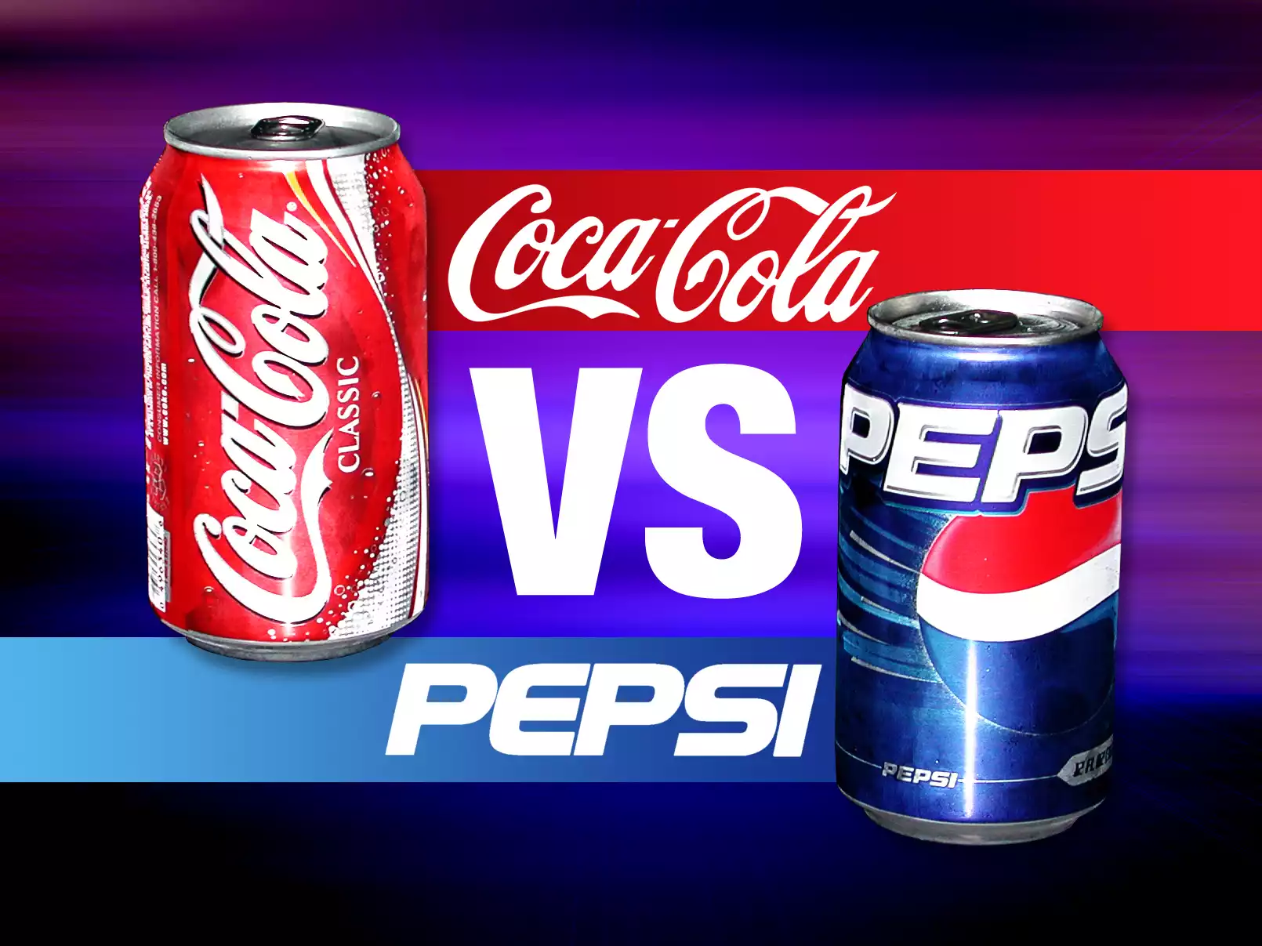
Thou shalt not…
Use loaded (AKA leading) questions
Don’t you think Coke tastes better than Pepsi?

Slide 40
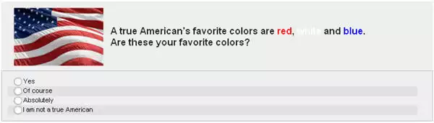
Thou shalt not…
Use biased or charged language
Too little money is being spent on welfare (19% agree)
Too little money is being spent on assistance to the poor (63% agree)
Notes:
Other words with affective valence: rape, violent, etc.

Slide 41
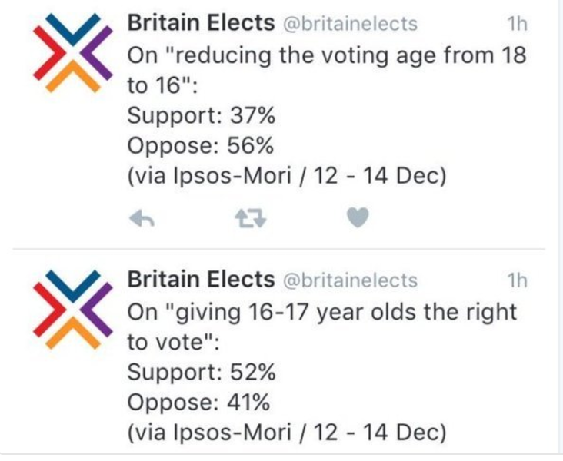

Slide 42
Let’s try it…
Draft some survey questions to assess:
People’s attitudes towards food available on campus (and what factors might influence these attitudes)
How much students like being at SUNY Purchase

Slide 43
What Should you do?

Slide 44
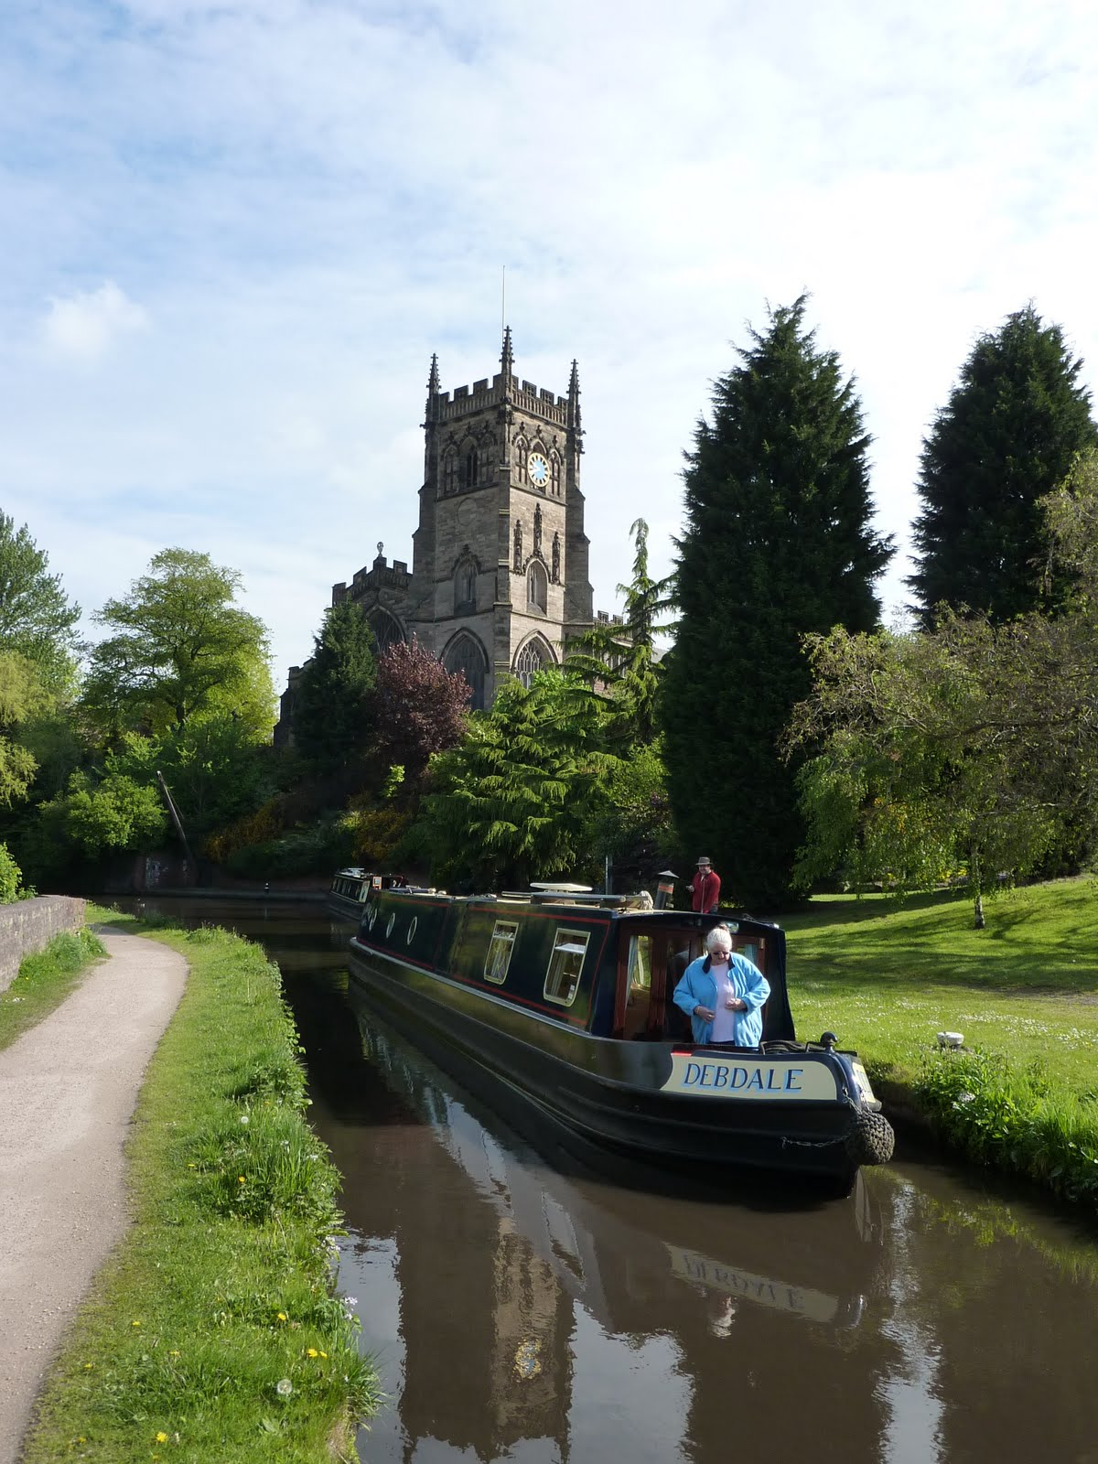
Thou shalt…
Establish a judgmental context
On a scale from 1 to 10, how much do you like warm and sunny days?
Compared to cold, rainy days?
Compared to winning the lottery?

Slide 45
Thou shalt…
Ask questions more than once (but not in the exact same way)
I feel that I am a person of worth, at least on an equal level with others
I feel that I have a number of good qualities.
All in all, I am inclined to feel that I am a failure (R)
I am able to do things as well as most other people
Notes:
Reverse-coding

Slide 46
Thou shalt…
Pay attention to ordering
Should divorce in this country be easier to obtain, more difficult to obtain, or stay as it is now?
23% easier, 36% more difficult, 41% same
Should divorce in this country be easier to obtain, stay as it is now, or more difficult to obtain?”
26% easier, 46% more difficult, 29% same
Shuman and Presser (1981)

Slide 47
Thou shalt…
10. Proofread and pay attention to design
Formatting
Should appear attractive and professional
Neatly typed and free from errors
Use rating scales consistently
Refining Questions
Proof questions with others
Pilot test the survey with a small group

Slide 48
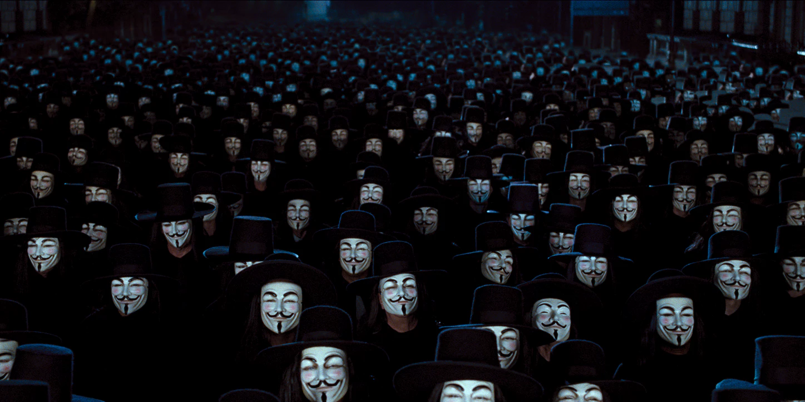
BONUS! Thou shalt…
11. Guarantee participants’ anonymity

Slide 49
Beware the Response Set
The tendency for (some) people to respond to questions from a particular perspective rather than provide (fully truthful) answers that are directly related to the questions
Often related to social desirability (“faking good”)
Most acute when questions concern a sensitive topic
violent or aggressive behavior (e.g., spousal abuse)
illicit behavior (e.g., substance use/abuse)
sexual practices
Notes:
However, not everyone misrepresents themselves!

Slide 50

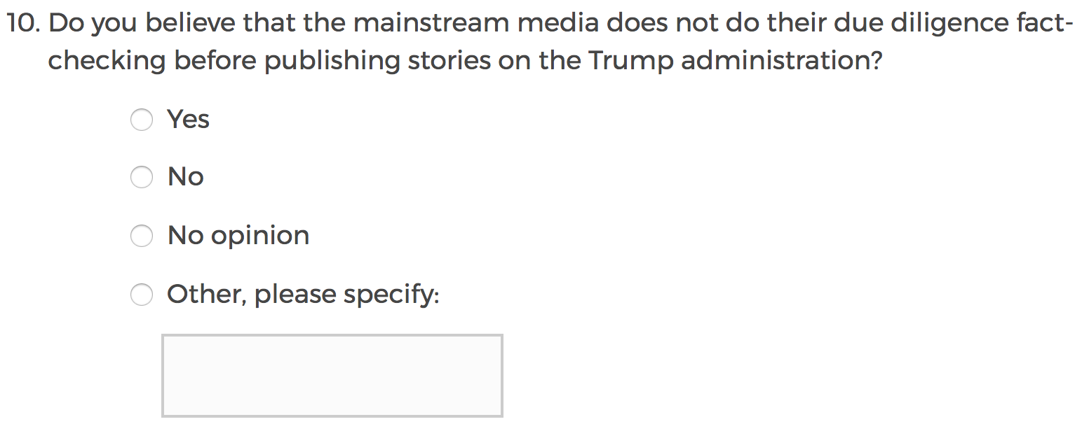

Slide 51
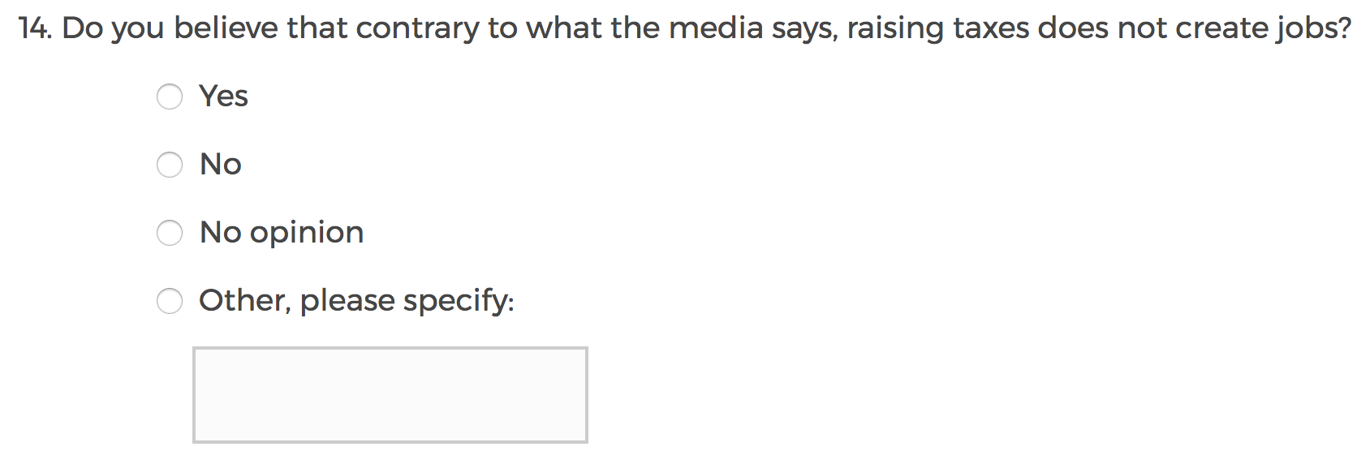

Slide 52
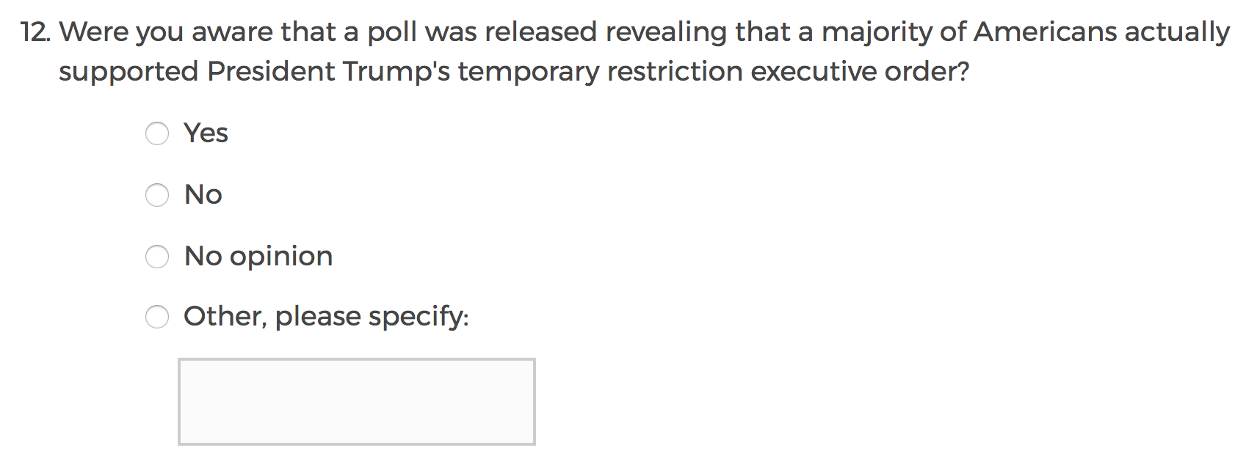

Slide 53
Let’s try it…
Draft some survey questions to assess:
People’s attitudes towards food available on campus (and what factors might influence these attitudes)
How much students like being at SUNY Purchase

